Slide 1
Practical Training on GraphPad Prism for Statistical Testing
Workshop date: Oct 9, 2019
Reach out to our team: bioinformatics@niaid.nih.gov
Jingwen Gu (jingwen.gu@nih.gov)
Biostatistician
NIAID/OCICB/BCBB/Science Support

Slide 2
Outline
Dependent variable is Continuous
Unpaired t-test vs paired t-test vs Mann-Whitney test
One-way ANOVA vs Repeated measures one-way ANOVA vs Kruskal-Wallis and Friedman tests
Multiple comparison
Dependent variable is Categorical
Chi-square test vs Fisher exact test

Slide 3
T-test and related nonparametric - Overall
T tests, and related nonparametric tests compare two sets of measurements (data expressed using an interval or ratio scale).
Paired or not paired?
Parametric or nonparametric?
Equal standard deviation or not?
Checklist: unpaired t-test, paired t-test, Mann-Whitney test
Kolmogorov-Smirnov test, Wilcoxon matched pairs test…

Slide 4
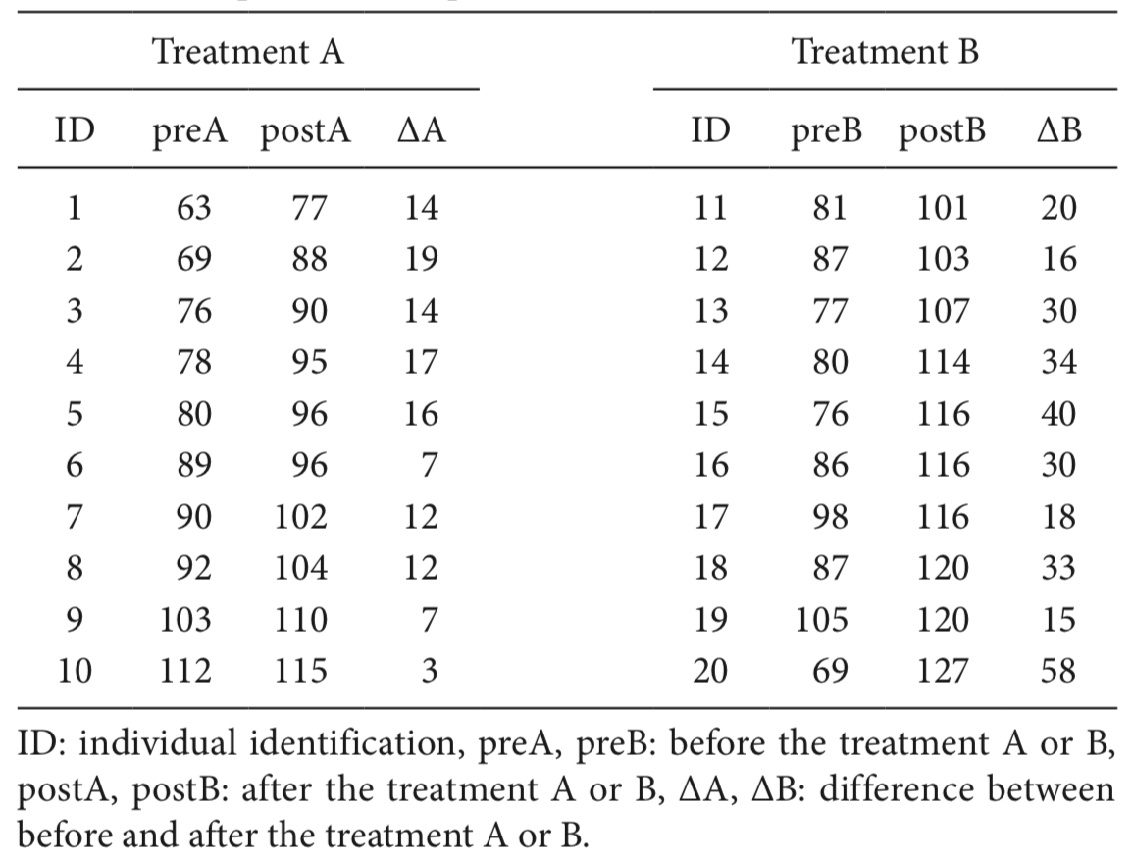
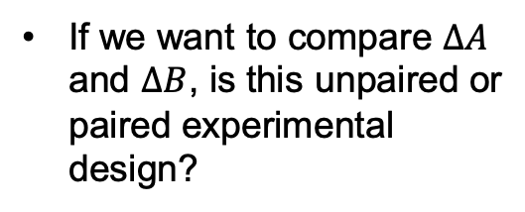
Unpaired or paired?
If we want to compare $∆A$ and $∆B$, is this unpaired or paired experimental design?
Unpaired.
Example Source

Slide 5
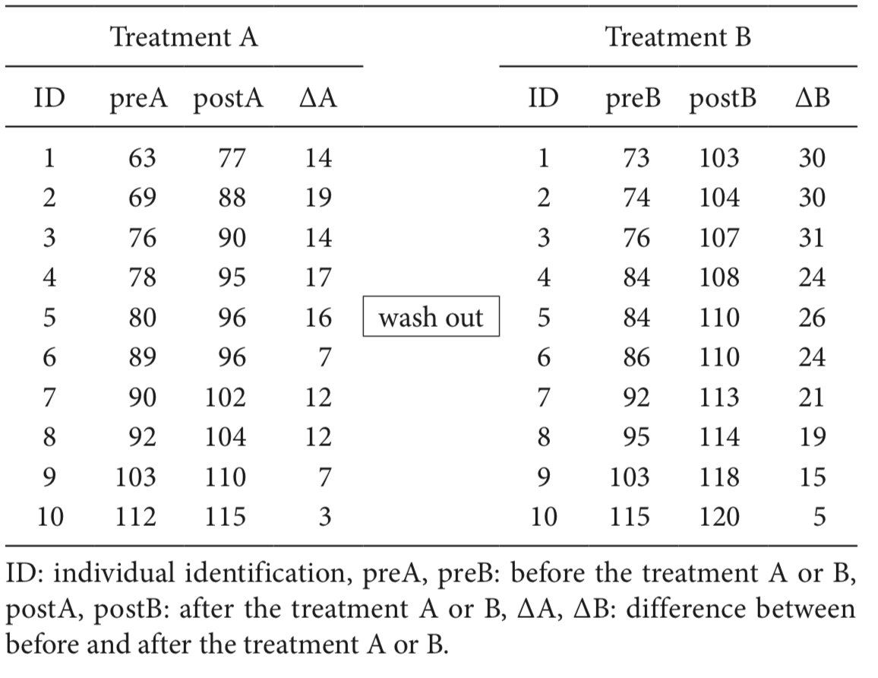
Unpaired and paired? Cont
If we want to compare $∆A$ and $∆B$, is this unpaired or paired experimental design?
Paired.
[Read more] Experimental design: unpaired or paired

Slide 6
Parametric or nonparametric?
If the data in both groups follow Gaussian distribution: use parametric test.
Parametric test:
The unpaired t test compares the means of two unmatched groups, assuming that the values follow a Gaussian distribution.
The paired t test compares the means of two matched groups, assuming that the distribution of the before-after differences follows a Gaussian distribution.

Slide 7
Parametric or nonparametric? Cont
If the data does not follow Gaussian distribution?
Data transformation
Use t-test anyway, given that t-test is robust when sample size is large.
Use nonparametric test.
The Mann-Whitney and the Kolmogorov-Smirnov compares the distributions of two unmatched groups. [Nonparametric]
The Wilcoxon matched pairs test compares two paired groups. [Nonparametric]
Nonparametric tests does not require Gaussian but have less power. Deciding when to use a nonparametric test is not straightforward.
[Read more] Assume Gaussian distribution? Choose test?

Slide 8
Let’s practice in Prism
Use sample data provided by Prism for hands on
Perform unpaired, paired t-test and related nonparametric tests.
Interpreting result:
Unpaired t-test, paired t-test, Mann-Whitney test, Kolmogorov-Smirnov test, Wilcoxon matched pair test.
Notes:
https://www.graphpad.com/guides/prism/8/statistics/interpreting_results_kolmogorov-smirnov_test.htm

Slide 9
One-way ANOVA and related nonparametric test
One-way ANOVA and related nonparametric test compare three or more sets of measurements (data expressed using an interval or ratio scale).
Paired or not paired (Matching/Repeat Measure)?
Parametric or nonparametric?
Equal standard deviation or not? Sphericity?
Checklist: ordinary one-way ANOVA, RM one-way ANOVA,
Kruskal-Wallis test, Friedman test…

Slide 10
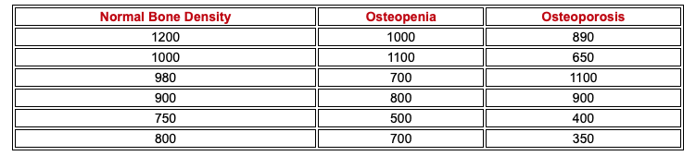
Unpaired or paired?
A study is designed to test whether there is a difference in mean daily calcium intake in adults with normal bone density, adults with osteopenia (a low bone density which may lead to osteoporosis) and adults with osteoporosis.
Unpaired
Example Source

Slide 11
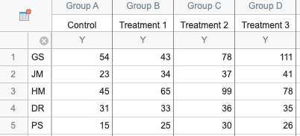
Unpaired or paired? Cont
The four columns represent four sequential treatments. Each row represents a different subject (or a different set of matched data).
Paired
(Repeat Measures)
Example source: Prism 8

Slide 12
Ordinary one-way ANOVA and related nonparametric test
Unpaired
Yes, Parametric
Yes,
Ordinary one-way ANOVA
No,
Brown-Forsythe and Welch ANOVA tests
No, Nonparametric
NA,
Kruskal-Wallis test
Experimental Design
*Parametric?
(Gaussian)
Equal SDs
* Deciding when to use a nonparametric test is not straightforward.

Slide 13
Repeated Measure One-way ANOVA and related nonparametric test
Pairing or matching
Yes,
Use ANOVA
Yes,
RM one-way ANOVA
No,
Use nonparametric test
Friedman test
Experimental Design
*Parametric?
(Gaussian)
Sphericity?
No,
RM one-way ANOVA with correction (Recommended)
Read more: 1 2
** Under this experimental design, if there is missing values, mixed effects model will be performed instead of ANOVA. Result only meaningful if the values are missing for random reasons.

Slide 14
Multiple Comparison
Prism provide an option of doing multiple comparison option when customizing your ANOVA analysis. It is usually noted as a post doc test in ANOVA, but however they could be performed independently.
[Definition] Multiple comparisons arises when a statistical analysis involves multiple simultaneous statistical tests, each of which has a potential to produce a “discovery.”
[Methods] Multiple comparisons corrected by statistical hypothesis testing; controlling the false discovery rate, don’t correct. If using a familywise definition of alpha, the significance level doesn't apply to each comparison, but rather to the entire family of comparisons. In general, this makes it harder to reach significance.
Read more: Methods

Slide 15
Let’s practice in Prism
Use bone density and calcium intake data to perform ordinary one-way ANOVA
Use the sample data provided by Prism to perform RM one-way ANOVA
Interpreting result:
Ordinary one-way ANOVA, RM one-way ANOVA, mixed model one-way, Kruskal-Wallis test, Friedman test.

Slide 16
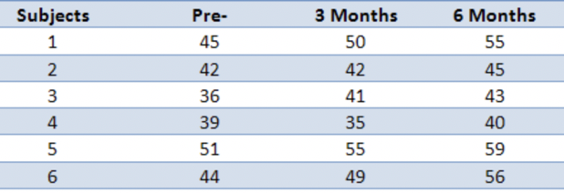
Challenging question
Exercise Intervention data: A 6-month exercise-training intervention where six subjects had their fitness level measured on three occasions: pre-, 3 months, and post-intervention. Their data is shown below along with some initial calculations:
Questions:
Is there any difference in fitness level on these three occasions?
If differences exist, compare group differences in 3 months intervention and 6 months intervention with the pre- group.
Source of question

Slide 17
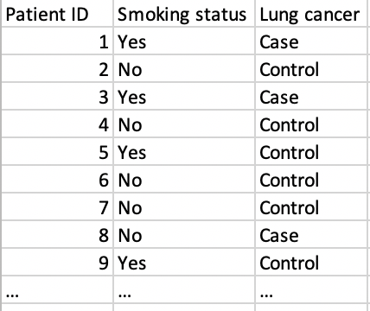
Test for data with categorical data
 | Lung Cancer
Smoker | Case | Control | Total
Yes | 688 | 650 | 1338
No | 21 | 59 | 80
Total | 709 | 709 | 1418
What is the appropriate test for seeing whether smoking is associated with lung cancer in a case-control study?

Slide 18
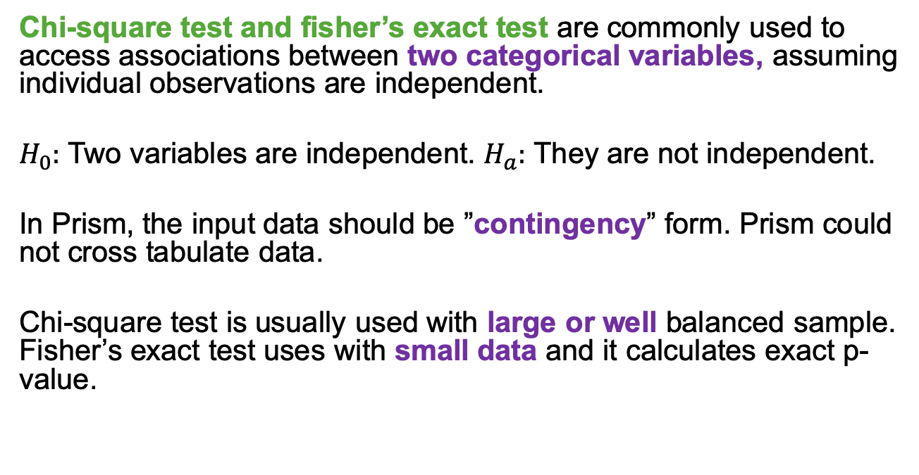
Chi-square test and Fisher’s exact test
Chi-square test and fisher’s exact test are commonly used to access associations between two categorical variables, assuming individual observations are independent.
$H_{0}:$ Two variables are independent. $H_{a}:$ They are not independent.
In Prism, the input data should be ”contingency” form. Prism could not cross tabulate data.
Chi-square test is usually used with large or well balanced sample. Fisher’s exact test uses with small data and it calculates exact p-value.

Slide 19
Chi-square test OR Fisher’s exact test?
Why not always Fisher’s exact test?
Fisher’s test is based on assuming that the row and column totals are fixed by the experiment, which is not satisfied in the design of a retrospective case-control study and a cross-sectional experiment.
In Prism, if you enter huge numbers (the sum is greater than 1,000,000), it will perform the chi-square test even if you chose Fisher's test.

Slide 20
Let’s practice in Prism
Use sample data provided by Prism
Perform Chi-square test and Fisher’s exact test to evaluate association.
Interpreting result:
Chi-square test and Fisher’s exact test

Slide 21
More tests for categorical data
Cochran-Armitage trend test is used for study association between a variable with two categories and an ordinal variable with k categories (e.g. dose-response studies).
McNemar’s test is used for comparing categorical responses for two samples that are statistically dependent.
Cochran-Mantel-Haenszel test for the analysis of stratified or matched categorical data.
…….

Slide 22
In the end
Statistics is a lot of fun! Continue to attend our workshop in future!
We try to improve! Please finish the survey and let us know your thoughts!
Check out our Github page, more related material has been uploaded.

